Slide 1
SAX: An innovative outlook to time series representations
Aayush Kumar, Sejal Mohata, Arjun Bahuguna and Soumya Ranjan Sabat

Slide 2




# Open Source Contributor
# AI Researcher
# Data Scientist,
Rorodata
# Contract Developer
# Visiting student - UC Berkeley
# Contributor, Data Science Society @ UCB
#AI Researcher
# Founder, PyData Ktr
# Blockchain Researcher
# ML in Privacy Enthusiast
# Contract Developer
# Intern at KPIT
#Previously, Intern at Siemens Nashik
#Previously,
Intern at Schneider Electric Vadodara

Slide 3
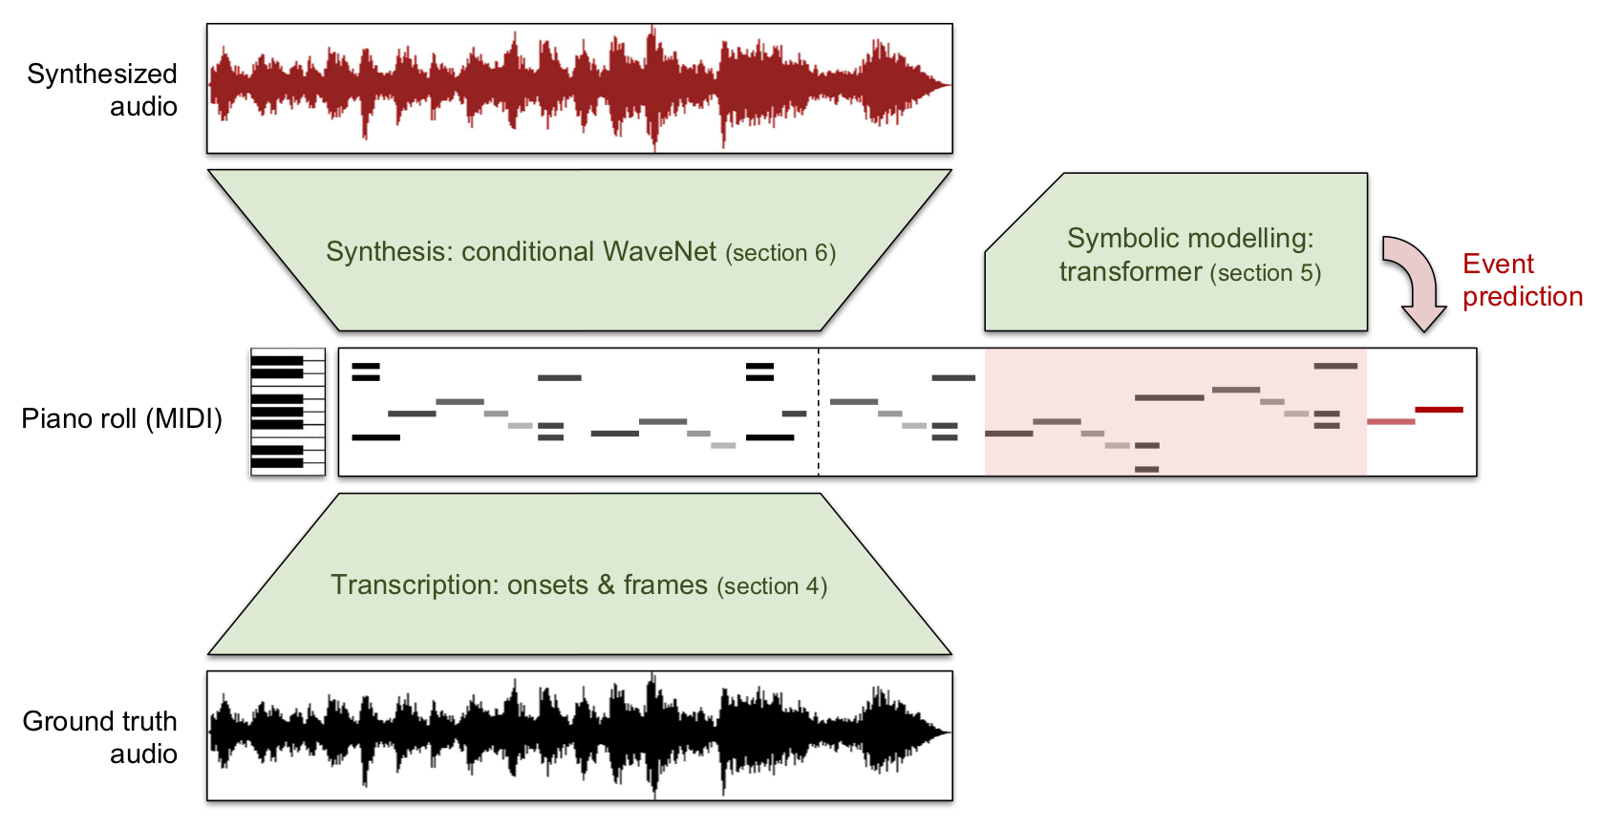
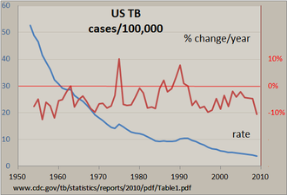
Time Series Data are Ubiquitous
Most commonly, a time series is a sequence taken at successive equally spaced points in time.
From Stock,
To music,
To weather forecasting,
To ECG,TB, Bio-Medical Data,
To Speech Synthesis
Etc ..

Slide 4
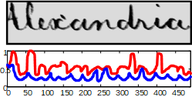
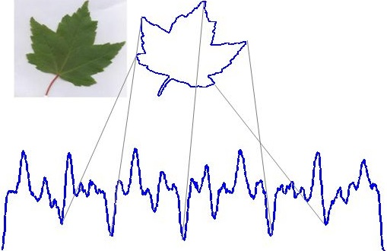
Time Series data are also found in Multimedia database

Slide 5
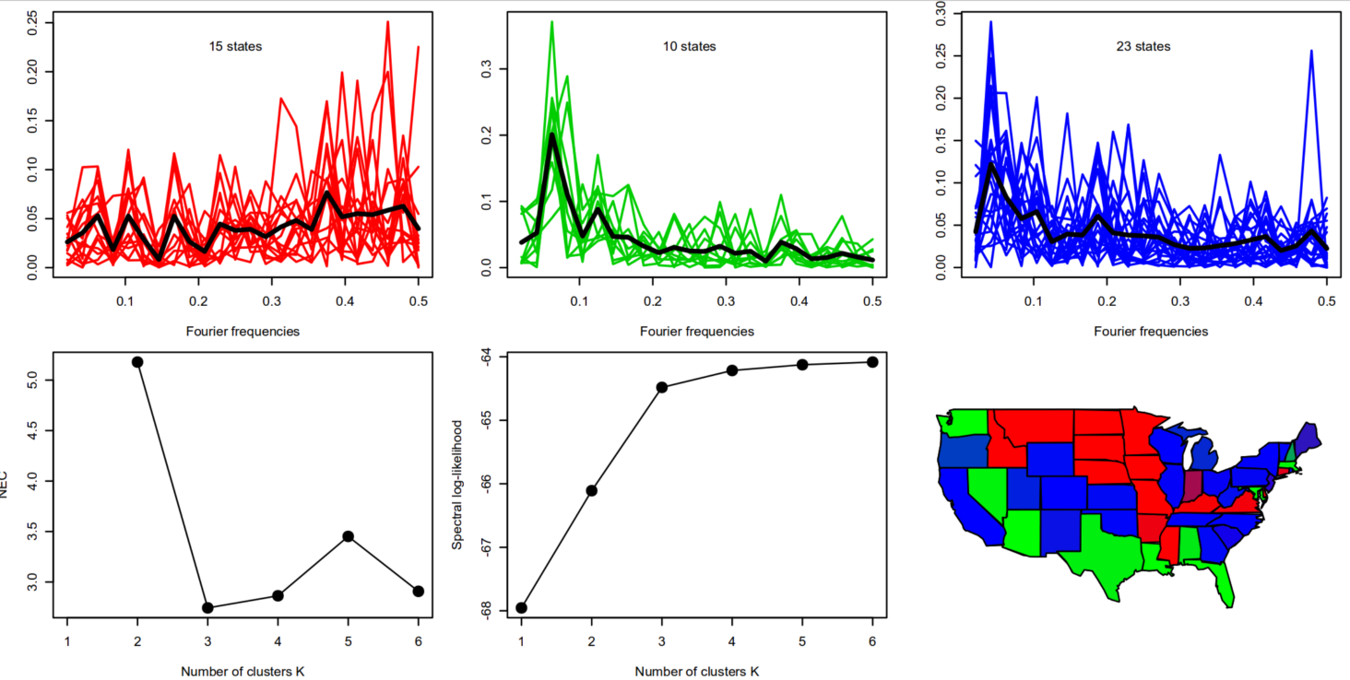
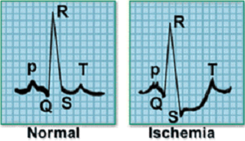
Time Series Data Can be used for huge number of Tasks
Clustering
Classification

Slide 6
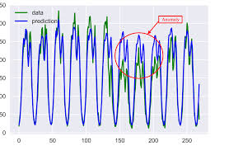
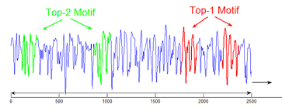
Anomaly Detection
Motif Discovery

Slide 7
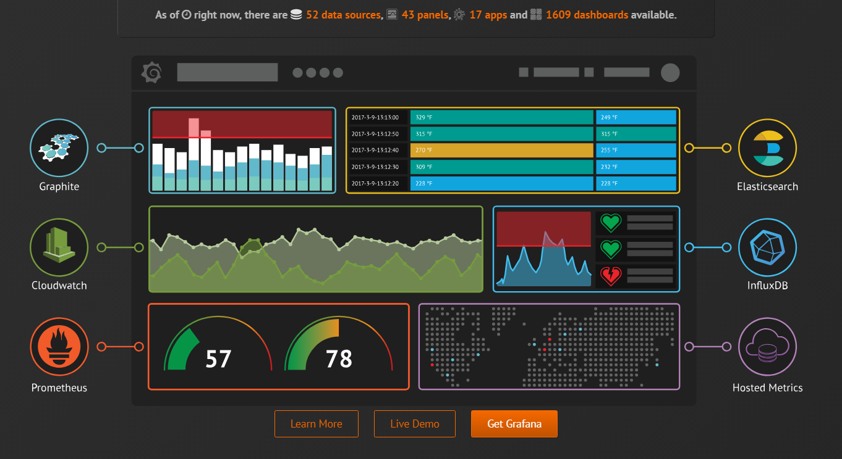
Query by Content (Indexing)

Slide 8
Solving these problems need to appoint
SIMILARITY MATCHING
SIMILARITY MATCHING can be achieved by taking the taking the Minimum distance metric
Minimum distance metric is calculated by
1. Euclidean Distance (EXACT distance)
2. Early Abandon of Euclidean Distance (Lower Bounding Approach)

Slide 9
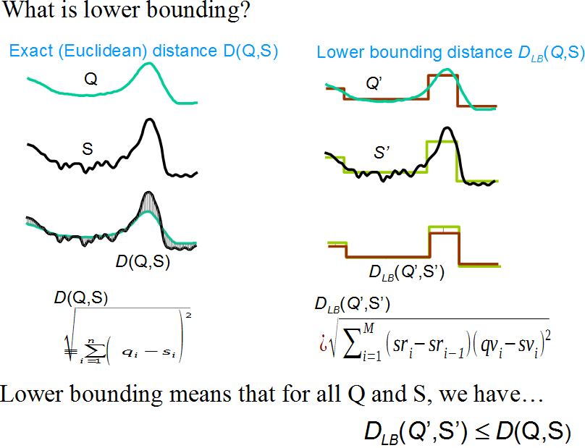
RAW DATA
Approximation or
Representation

Slide 10
Lower Bounding Supports
Symbolic Representation of time series data
Dimensionality Reduction
Hashing
Decision Trees
Markov Models
Text Processing
Bio-informatic Sequencing

Slide 11
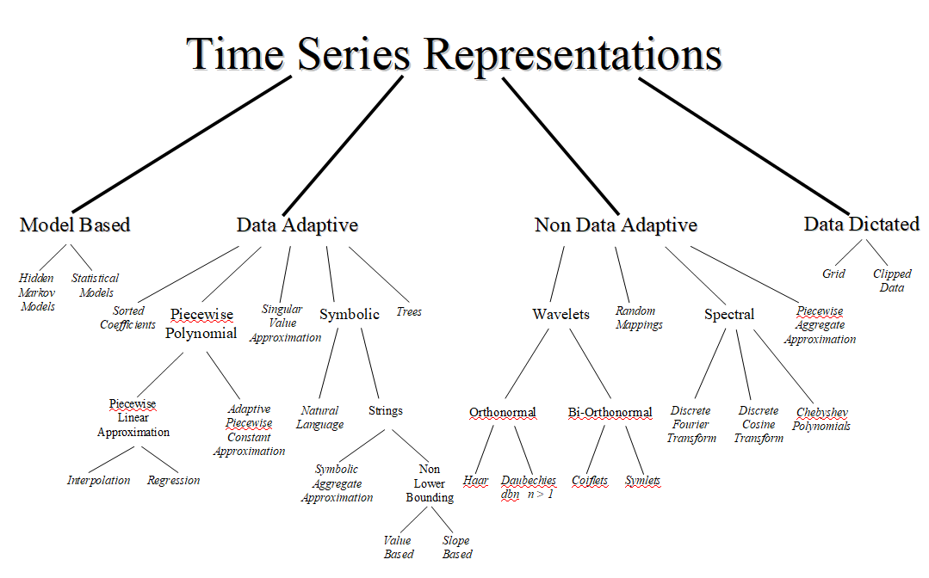

Slide 12
One Symbolic Representation that allows
Lower Bounding of Euclidean Distance
Lower Bounding of the time series data
Dimensionality Reduction
Numerosity Reduction : Technique of choosing smaller volume of data or data representation

Slide 13
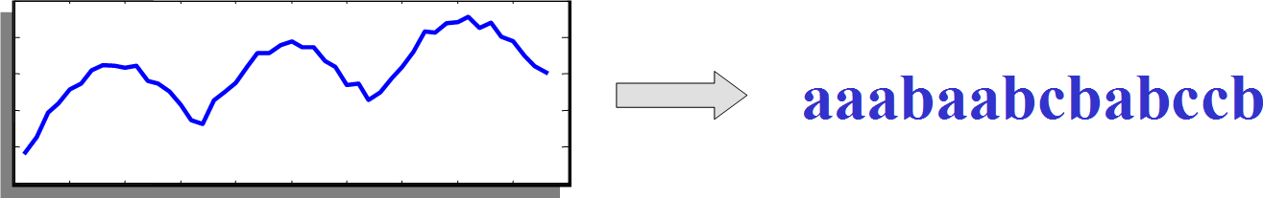
Is SAX: Symbolic Aggregate ApproXimate

Slide 14
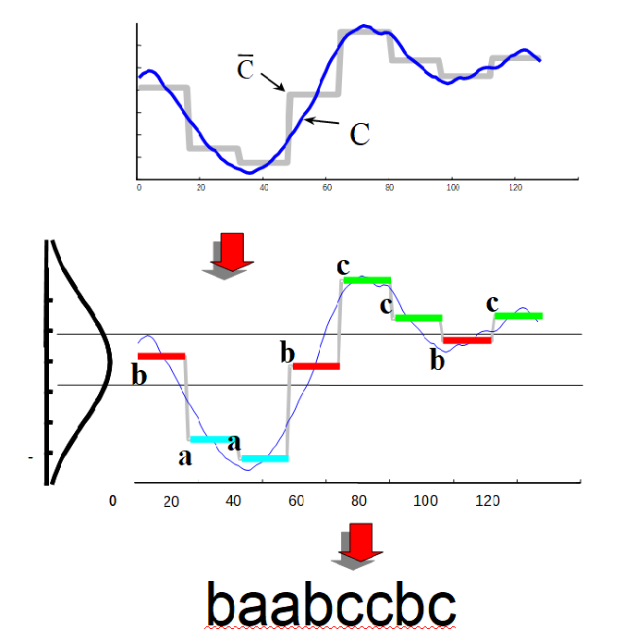
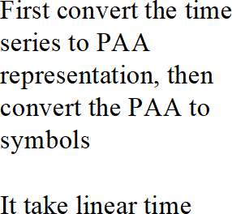
How to get SAX String ?

Slide 15
How to obtain SAX?
First convert the time series to PAA representation, then convert the PAA to symbols
It takes linear time.
Data is divided into w equal-sized frames
A mean value of the data falling within the frame is calculated
Vectors of these values become PAA
Reduce Dimensions by PAA

Slide 16
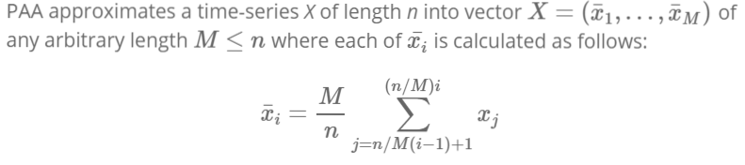

Slide 17
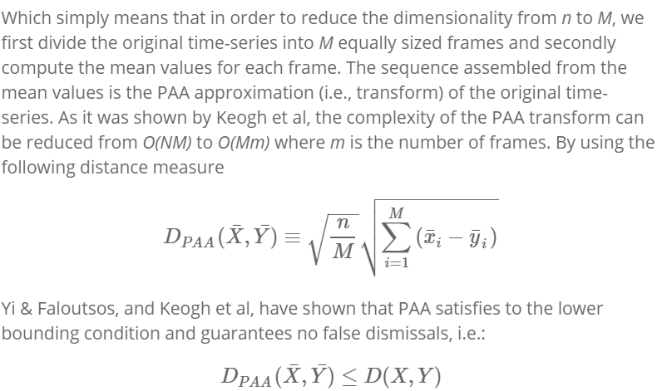
Lower Bounding Condition Satisfied

Slide 18

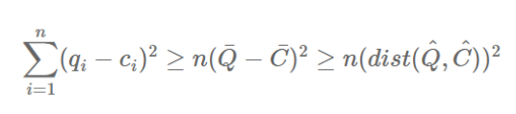
SAX transforms a time-series X of length n into the string of arbitrary length ω, where ω«nω«n typically, using an alphabet A of size a > 2. The algorithm consists of two steps: (i) it transforms the original time-series into the PAA representation and (ii) it converts the PAA data into a string.

Slide 19
Summary

Slide 20
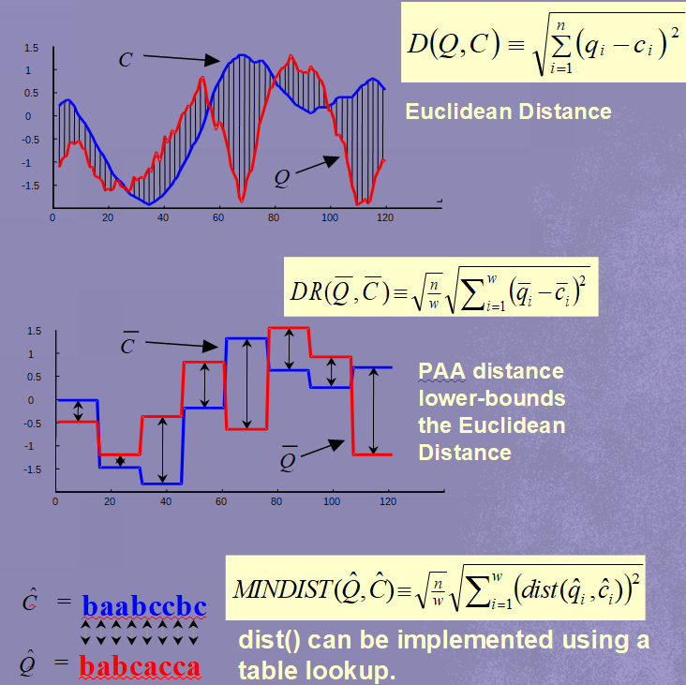

Slide 21
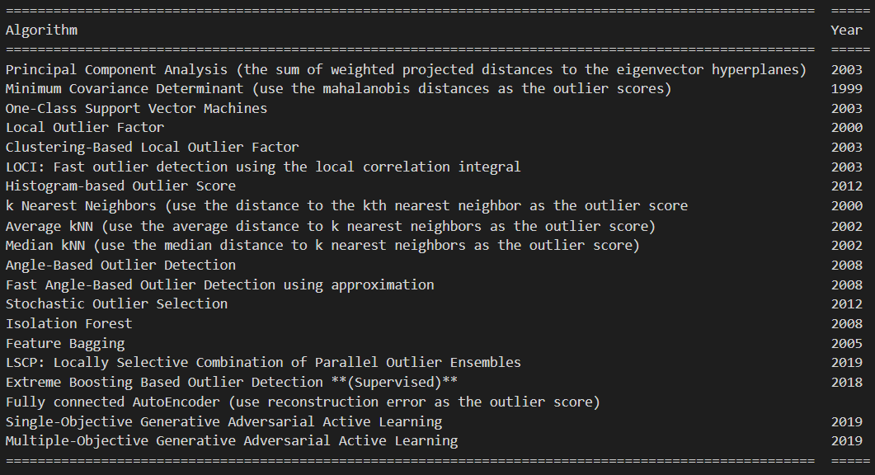
Is SAX the best ?
Yes!
2. Are, there any other algorithms for time series database?
Yes!
3. Does SAX outperforms those algorithms?
Yes!
4. How?
Let’s See, together!

Slide 22
FACTORS | SAX | ARIMA | RNN | LSTM | Class SVM | Generative Adversarial Learning
COST | Very Cost Efficient | Very Cost Efficient | Slightly Expensive | Expensive | Very Cost Efficient | Very Expensive
COMPUTE | Low Compute Cost, CPU,GPU | Low Compute Cost, CPU,GPU | Certain Compute power is needed GPU | Certain Compute power is needed GPU | Low Compute Cost | Huge Compute power is needed GPU at time TPU also..!
Data Preprocessing | Necessary | Necessary | Necessary | Necessary | Need not be mandatory | Necessary
Tasks capability | Forecasting,anomaly detection,motif,classification etc. | Only Forecasting | Forecasting, Predictive analytics | Forecasting, predictive analytics, anomaly detection, novelty detect | Only Classification,Clustering | Forecasting, predictive analytics, anomaly detection, novelty detect
Training Time | Few Hrs | Few Hrs | Few Hrs To days | Few Hrs To days | Few Hrs | Few Hrs To days To months

Slide 23
Utilities of SAX:
SAX revolutionizes the way of how things work in both
Industry & Academia
Following Areas are changed if SAX is introduced
Industries (Non Internet Sectors as well)
Manufacturing (Supply Chain Optimization gains momentum via using SAX)
Agriculture (Generating renewable source of soil fertility)
Energy (IoT enhanced data wearable technology, predicts simplest routes )
Logistics
Education

Slide 24
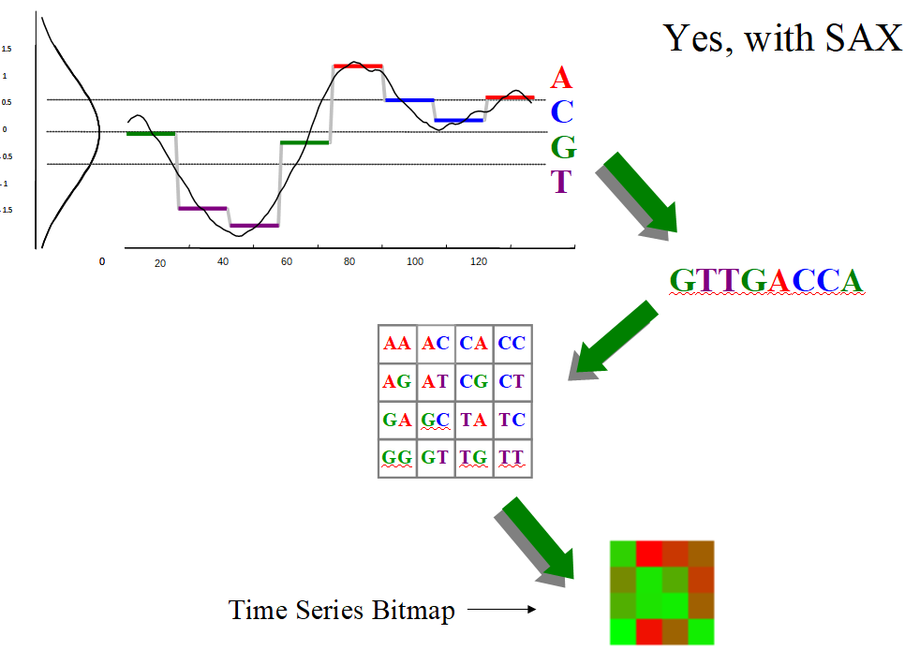
Research Industry:
Computer Vision
Natural Language Understanding
HealthCare

Slide 25
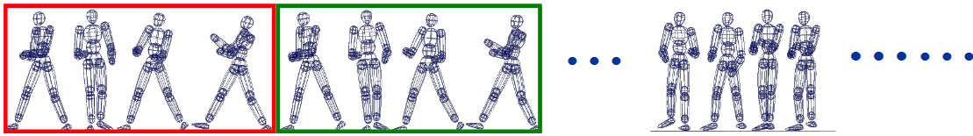
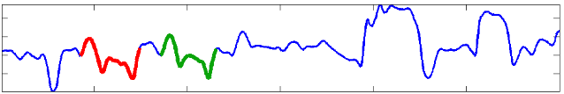
Motif helps in Motion Capturing, Rendering and Special Effects

Slide 26
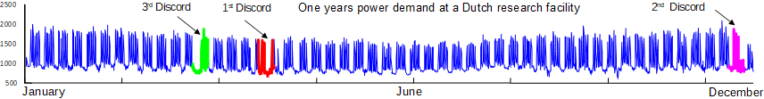
Time Series Discords
Power Supply and Demand

Slide 27
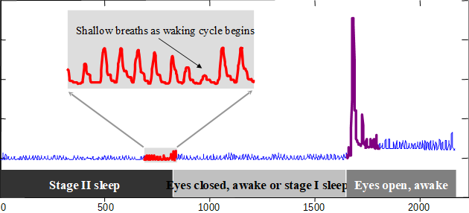
Sleep Cycle Discords

Slide 28
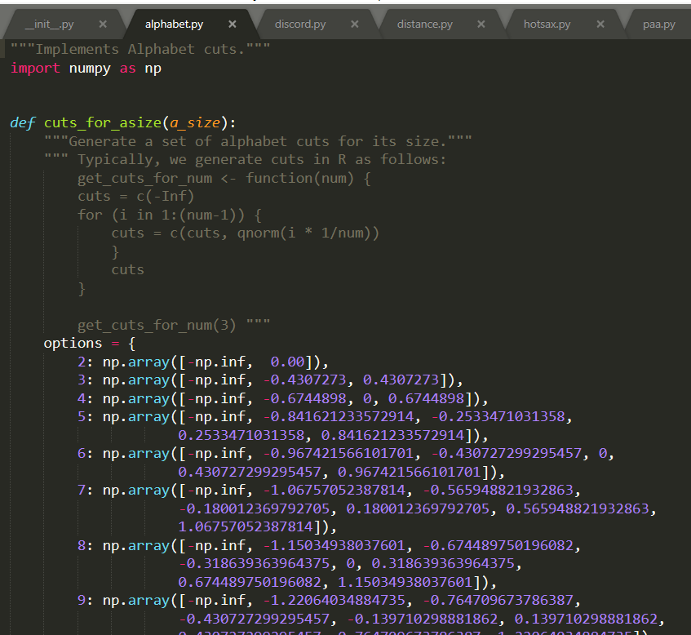
alphabet.py

Slide 29
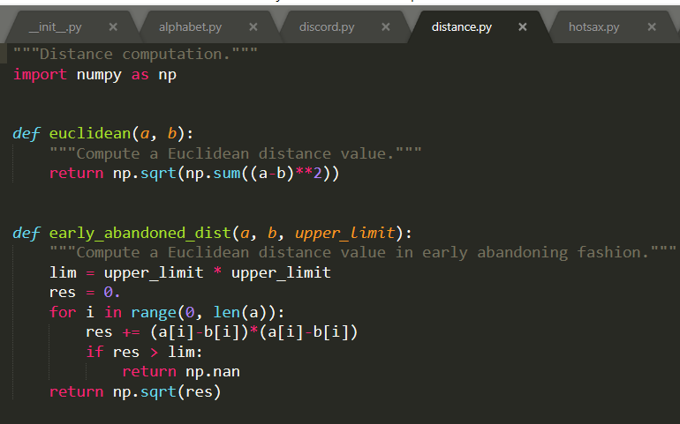
distance.py

Slide 30
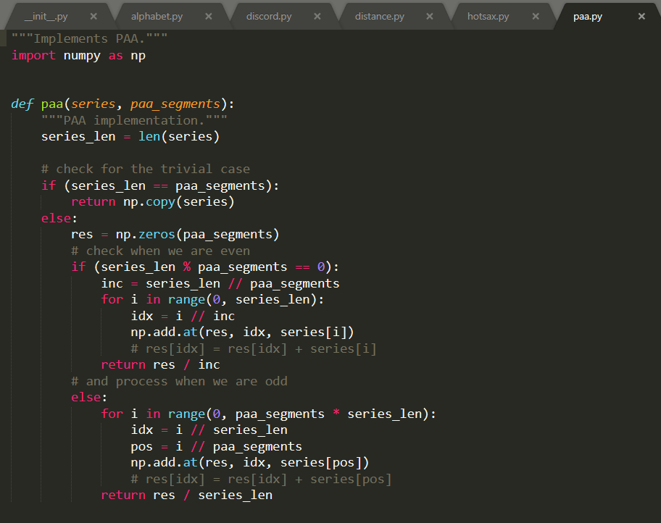
paa.py

Slide 31
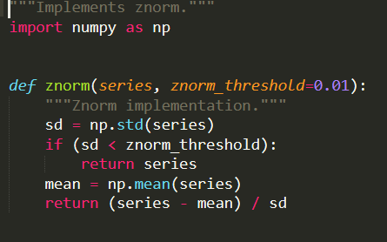
Z-Normalization

Slide 32
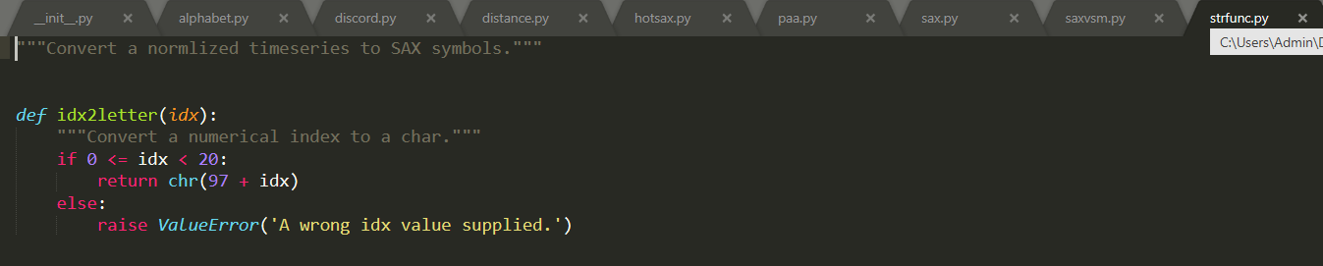
strfunc.py

Slide 33
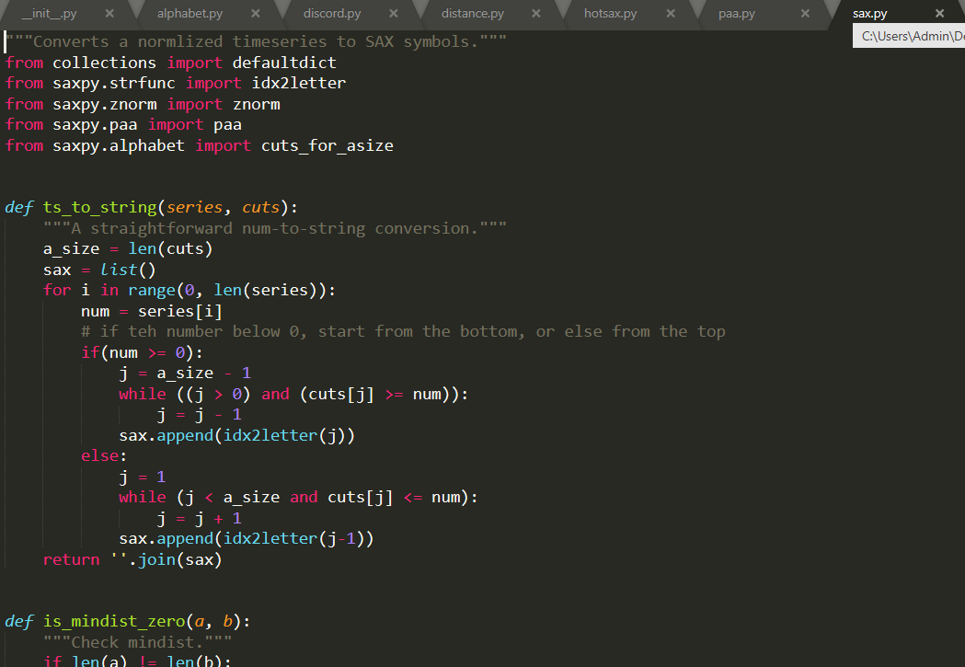
sax.py

Slide 34
The End :)

